Slide 1
Improving Cybersecurity Culture in the Workplace: A Study of Training Practices and Perceptions
Group Name: We've Been Trying To Reach You About Your Car's Extended Warranty
Group participants names: James Henderson; Patricia Montoya; Maxwell Stolarenko

Slide 2
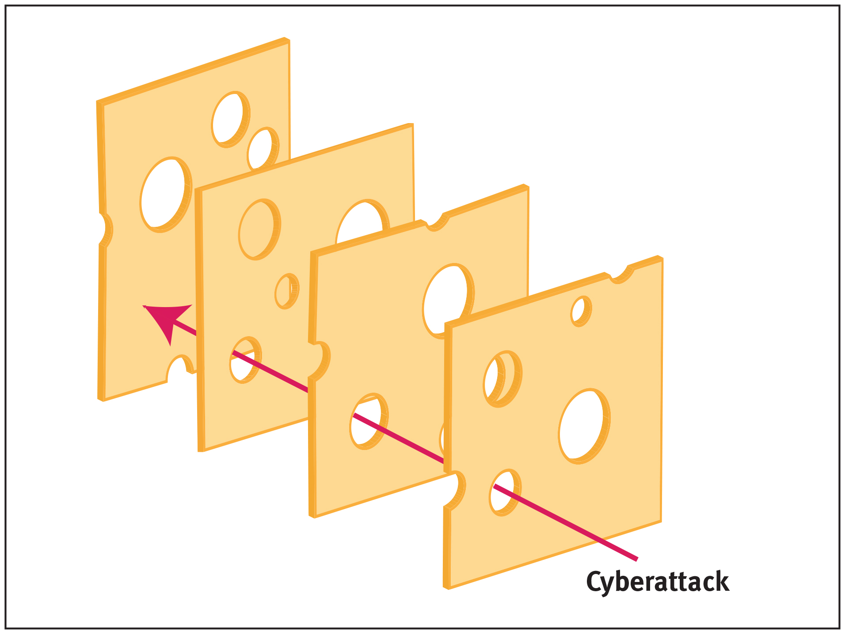
Introduction to the study
In 2020, the FBI's Internet Crime Complaint Center received over 240,000 complaints related to phishing attacks with an estimated 4.2 billion dollars lost to cybercrimes. Phishing and Fraud Report discovered a 220% increase in phishing attacks in response to the pandemic increasing cybercriminal opportunities.
There is a need for training programs that are not only effective in preventing phishing attacks but also easy for users to engage with and understand.
Our research proposal aims to investigate the relationship between perceived ease of use and perceived usefulness regarding a phishing prevention training programs

Slide 3
Research Questions and Objectives
How do employees perceive the usefulness of cybersecurity training in their workplace, and what factors influence their perceptions?
What specific aspects of cybersecurity training do employees find most useful or valuable, and why?
Our research aims to:
To investigate the role of perceived ease of use and perceived usefulness in cybersecurity training programs
To identify which aspects of phishing prevention training influence an employees’ attitudes and behaviors
To provide recommendations for improving the design and delivery of training methods to enhance effectiveness

Slide 4
Literature Review
The Importance of Training the Human
Phishing preventive strategies include technical tools and non-technical skills relevant to human behavior. Technical tools do not have a perfect success rate, facilitating the need to reinforce the human as well with training (Jampen et al., 2020).
Perceived Usefulness of Phishing Training
Participants that placed little trust in the usefulness of their phishing detection tools and instead relied on intuition noticeably fell for significantly more phishing attempts (Abbasi et al., 2016).
Perceived Ease of Use of Phishing Training
Participants may develop improper cybersecurity habits, actively seek workarounds, or be prone to making more frequent errors from cyber fatigue in both directions of how they perceive difficulty and frequency (Reeves et al., 2021)

Slide 5
Literature Gaps
Research on the perceived usefulness of phishing prevention only covered using technical tools and not training the human
The perceived ease of use literature covered did not focus specifically on phishing training nor did it employ self-report measures for a qualitative understanding

Slide 6
Operational Definitions
Cybersecurity - Knowledge and awareness of signs and countermeasures against cyber threats, in the context of phishing attacks.
Training - The education, instruction, or discipline of a person or thing that is being trained.
Phishing - Cyber attack directed at key individuals or large groups by disguising a malicious attack as a reputable organization or entity.
Perceived Usefulness - A subjective opinion based on a persons understanding of cybersecurity effectiveness.
Perceived Ease of Use - A subjective opinion on the difficulty/lack of difficulty of cybersecurity training.
Industry professional - A person that works in a corporate office environment.
Elite Bias – A phenomenon that occurs when researchers fail to gain an understanding of the broader situation by only focusing on the perceptions of certain people of a high status.

Slide 7
Research Methodology
This case study will identify the quality of the content presented in training and the perceived quality of the content according to the trainees.
The research will focus on industry professionals who are familiar with cybersecurity trainings but will not have above-average awareness of cybersecurity
Through snowball sampling, chosen participants will fill out the Qualtrics survey composed of open-ended questions and 5-point Likert scale questions.
Following the survey, participants will receive a short phishing training followed by open-ended questions to further explore their perceptions on these types of trainings.

Slide 8
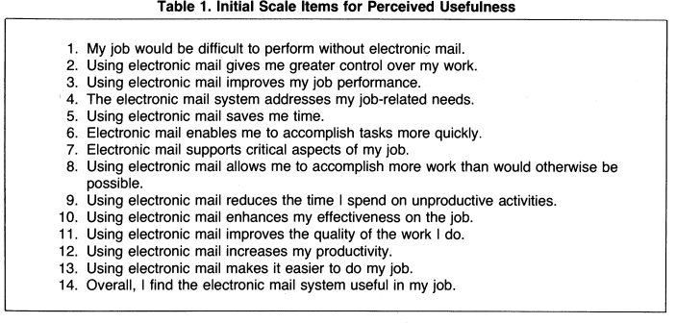
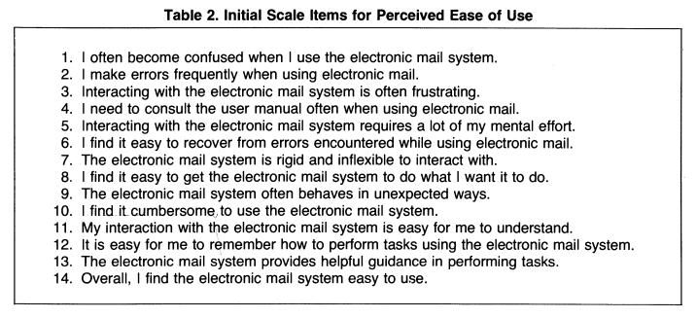
Developmental Journey: Survey
Demographic questions and open-ended questions for perceived ease of use and perceived useability were developed through a combination of structured interviews with UCF faculty member Dr. Crystal Maraj.
Perceived Ease of Use and Perceived Useability survey questions were developed through adapting existing surveys from previous relevant literature (Davis, 1989).
UCF’s Qualtrics system was used to develop the survey due to its security and ability to quickly generate data analysis.

Slide 9




Developmental Journey: Training Module
An inclusion criteria list was developed based on our research questions. The cybersecurity training module must:
Focus solely on phishing recognition and prevention
Contain a combination of text, videos, and demonstrations.
Be easy for participants to pick up and understand but complex enough for participants to feel they are learning from it.
Include an interactive segment involving assessing examples of phishing attacks.
8 different online training courses were found via internet searching but none fit our inclusion criteria.

Slide 10


Developmental Journey: UCF Cybersecurity Phishing Training
Reaching out to UCF faculty member Dr. Bruce Caulkins connect research team to UCF’s IT department who shared their employee phishing training course.
Research team agreed this training course was the best fit based on our criteria.

Slide 11
Data Collection and Expectations
The pretest will gather information on participants' expertise on cybersecurity, previous training, frequency of engagement with networked computers, experience with phishing, and perception of cybersecurity training.
An interview will be conducted with a mix of open-ended and structured questions to explore participants' insights, their perceived level of understanding of the training content, and the extent to which the training has influenced their behavior and decision-making.
After engaging with the learning material, participants will be given a short quiz to test their level of understanding and the effectiveness of the training. The data collected from the quiz will be used to determine areas that need improvement in the training.

Slide 12
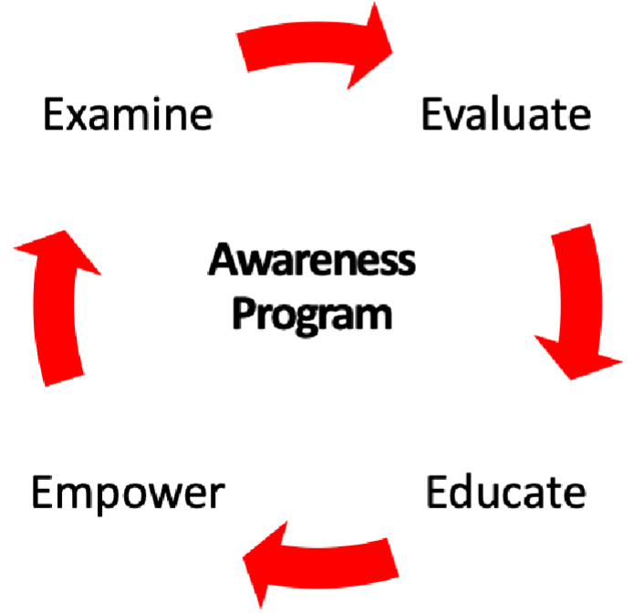
Study Timeline
Study introduction and informed consent form (5 minutes)
Demographic Survey (5 minutes)
Cybersecurity Training Module (12 minutes)
Interactive Game (8 minutes)
Perceived Ease of Use/Perceived Usefulness Survey (5 minutes)
Debriefing Procedures (5 minutes)

Slide 13
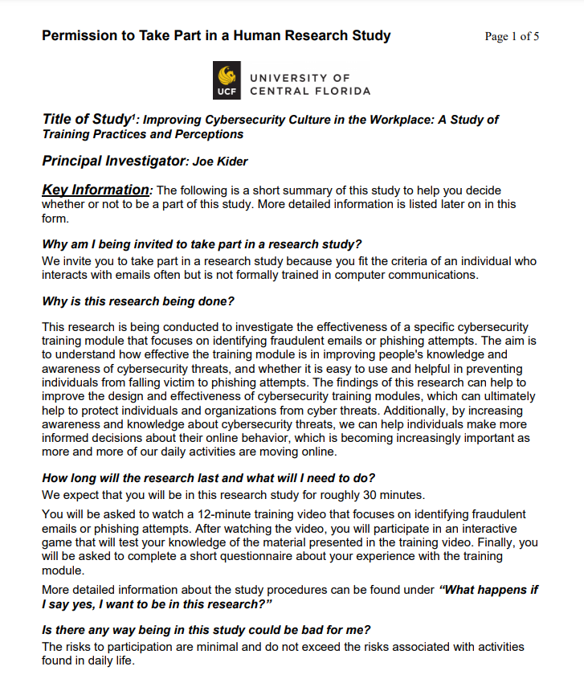
Study Procedure: Introduction/Informed Consent
Research team member will provide a verbal overview of the study, a summary of the overall structure of the study, and estimated duration to completion to the participant.
Participant will also be provided with a physical copy of an informed consent form covering what the tester explained.
Participant is free to ask any questions regarding they may have of the study to the tester.

Slide 14

Study Procedure: Demographic Survey
Participant will be informed to direct their attention to the laptop in the lab setting. The laptop will have two tabs: one with the survey and another with the training course.
Participant will be asked to complete the first page of the survey to gather demographic data which includes age range, years of experience using computers, employment status, and type of career work.
Determining period for exclusion criteria. If participant works in a highly technical background, we must consider them above average in computer literacy and no longer fit for our population.

Slide 15

Study Procedure: Training Module
Participant will be instructed to leave the survey tab open after completing the demographic questions and switch tabs to the cybersecurity training module.
Training module will consist of a combination of explanatory images, videos, text passages, and demonstrations for teaching behaviors to recognize and report phishing attempts.

Slide 16
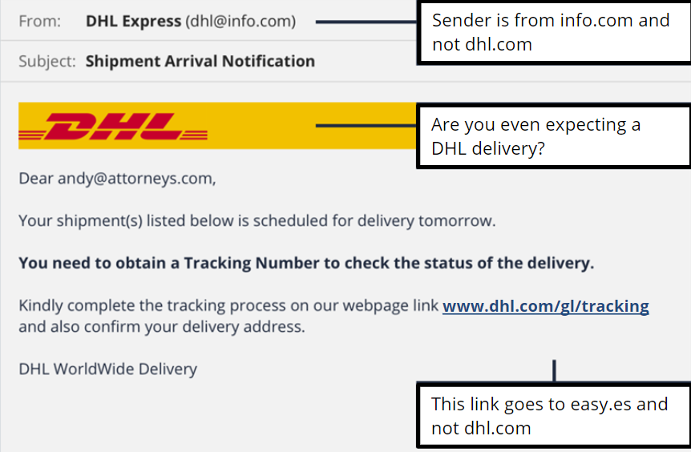
Study Procedure: Interactive Game
Immediately following the cybersecurity training module, participants will be directed to open the interactive cybersecurity game to test their ability to differentiate phishing emails from genuine emails.
Incorrect guesses for each email example provides participants with explanations for what to spot in phishing attacks
An overall accuracy score is provided based on their performance

Slide 17
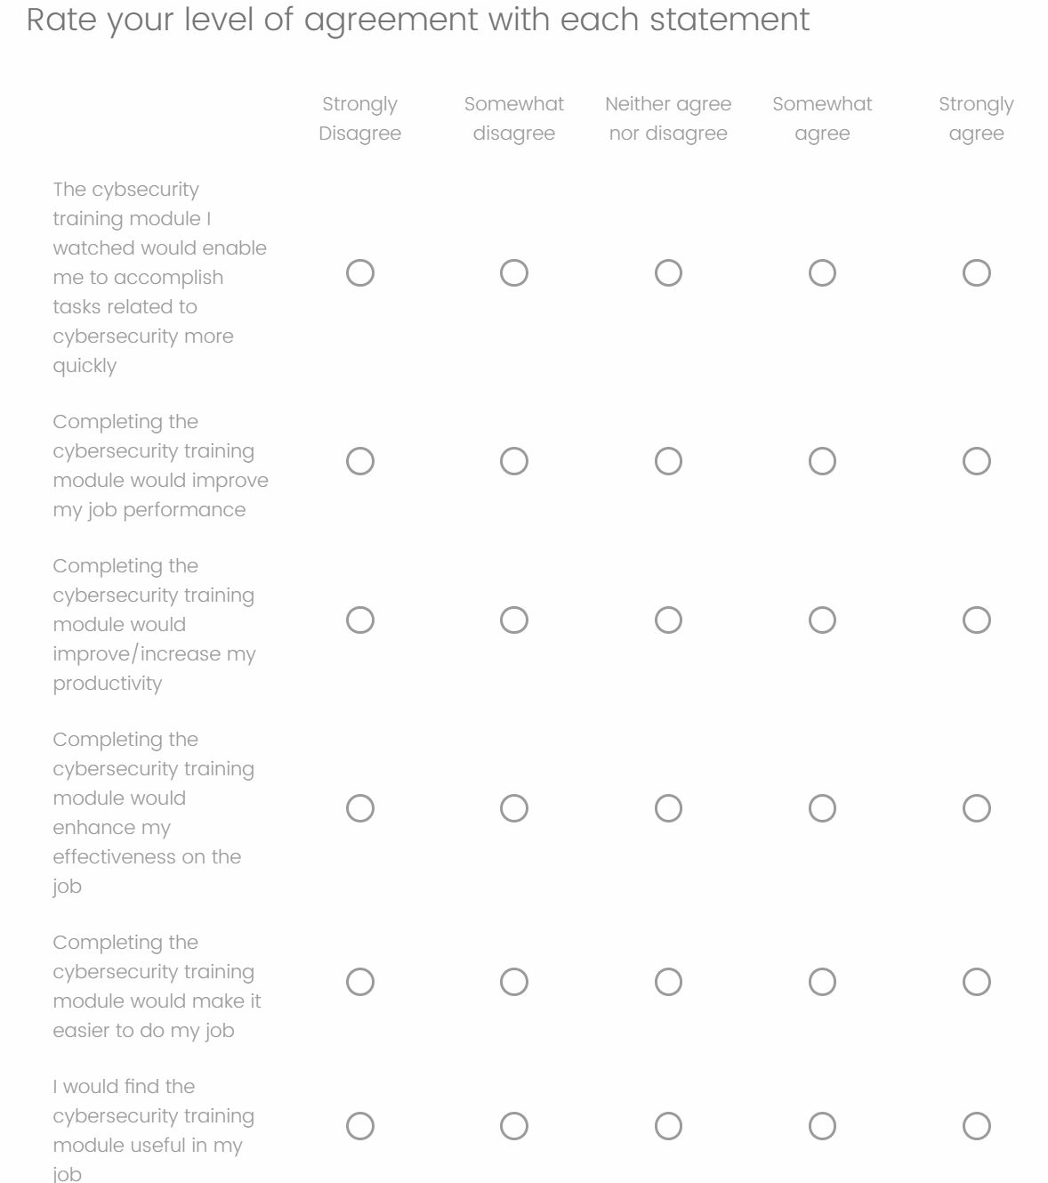
Study Procedure: Perceived Ease of Use/Perceived Useability Survey
Participants will then be instructed to switch back to the survey tab to report their feelings and attitudes towards the training course they just took.
Survey questions are designed around a 5-point Likert scale to measure strong emotional responses in the context of perceived ease of use and perceived useability.
Participants will also complete six open-ended questions about what aspects of the training course were the most noteworthy or helpful.

Slide 18
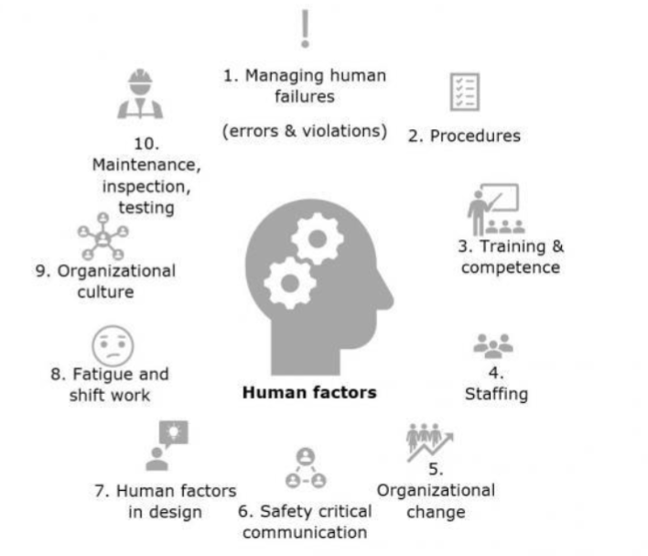
Study Procedure: Debriefing
Once completing the survey, participants will be debriefing by the research team member over the nature and purpose of the study they participated in.
Participants will be provided with a debriefing form that has contact information if the participant has any questions.
Participant will also receive a $5 gift card as compensation for their time.

Slide 19
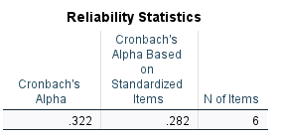
Data Analysis: Cronbach’s Alpha

Slide 20
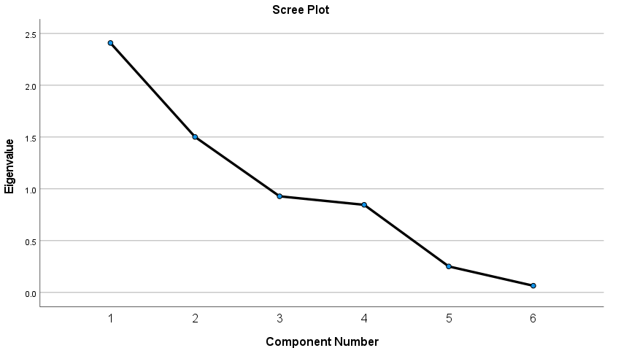
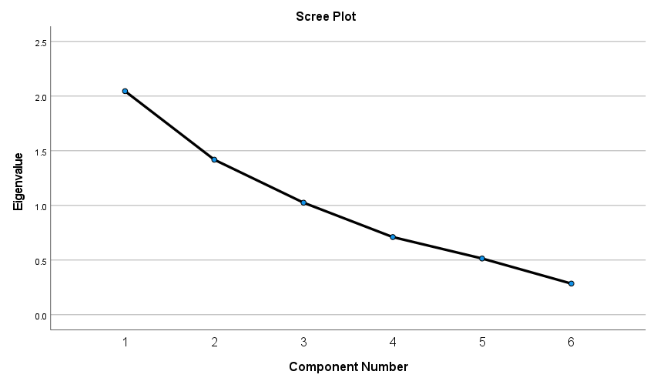
Data Analysis: Exploratory Factor Analysis

Slide 21
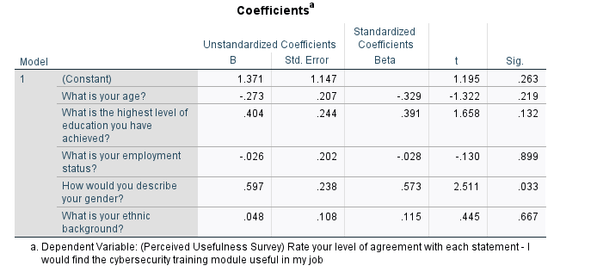
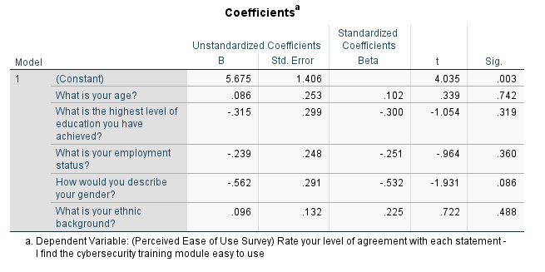
Data Analysis: Linear Regression

Slide 22
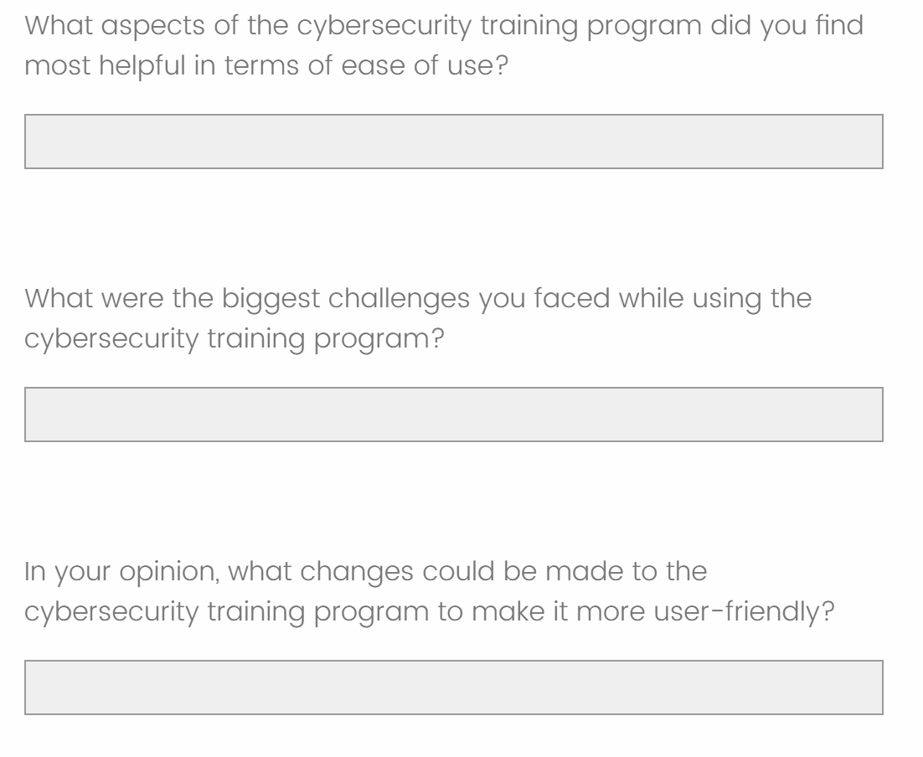
Data Analysis: Open-Ended Question Coding

Slide 23
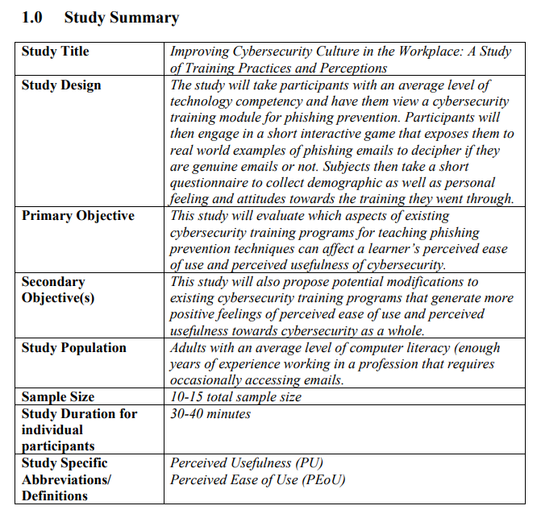
Additional Notes: IRB Approval
An IRB form was developed in the event the study had the affordance to go beyond a proposal.
Explains in detail:
Study design and procedures.
Ethical responsibilities with testing human participants.
Proper handling of sensitive data collected from participants.

Slide 24
Conclusion
Problem Statement: Organizations lack an understanding of which factors influence an employee’s perceptions of the usefulness and value of cybersecurity training. Identifying these factors can improve the effectiveness of training programs and enhance overall security.
Research Question: What are the factors that influence employees' perceptions of the usefulness and value of different aspects of cybersecurity training in the workplace?

